Slide 2
Diving into Mastery Guidance for Educators
Each activity sheet is split into three sections, diving, deeper and deepest, which are represented by the following icons:
These carefully designed activities take your children through a learning journey, initially ensuring they are fluent with the key concept being taught; then applying this to a range of reasoning and problem-solving activities.
These sheets might not necessarily be used in a linear way. Some children might begin at the ‘Deeper’ section and in fact, others may ‘dive straight in’ to the ‘Deepest’ section if they have already mastered the skill and are applying this to show their depth of understanding.
Diving
Deeper
Deepest

Slide 3
Aim
Recognise the per cent symbol and understand that per cent relates to ‘number of parts per hundred’, and write percentages as a fraction with denominator 100, and as a decimal.

Slide 4
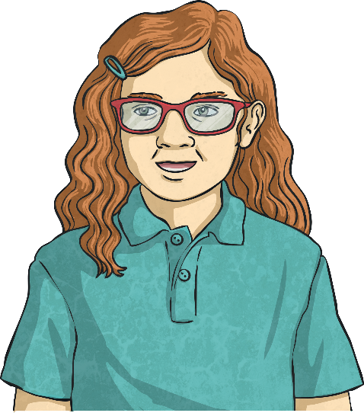
Understand Percentages
Diving
Complete the statements about the 100 square.
There are parts per 100 shaded.
% is shaded.
34
There are parts per 100 shaded.
% is shaded.
8
34
8

Slide 5
Understand Percentages
Diving
Put these percentages in order, from the smallest to the largest value percentage represented.
a) 73 parts per 100
c) 7%
b)
d)
c) 7%
b)
d)
a) 73 parts per 100

Slide 6
Insert White Rose Aim Here
Understand Percentages
Deeper
Ben colours in the whole of this 100 square using different colours.
He is only allowed to use colours in the percentage amounts given below:
45% = red | 10 parts per hundred = yellow
25% = green | 60 parts per hundred = pink
55% = black | 20 parts per hundred = blue
35% = orange | 5 parts per hundred = purple
Find different ways that Ben could colour in the whole 100 square using only 2 or 3 different colours.
Find a way of colouring in 100% of the square that uses exactly 4 colours. Can you find more than one answer?
Various combinations are possible:
red (45%) + orange (35%) + blue (20%)
black (55%) + green (25%) + blue (20%)
pink (60%) + orange (35%) + purple (5%)
red (45%) + black (55%)
Answers vary. example answers shown:
blue (20%) + green (25%) + red (45%) + yellow (10%)
pink (60%) + green (25%) + yellow (10%) + purple (5%)

Slide 7
Understand Percentages
Deepest
Before it got torn, Jack had coloured blue 45% of a 100 square.
Which of these torn pieces could have been from Jack’s 100 square? Which could not? Explain your answers fully.
This could not be part of Jack’s square: we can see that 73 out of 100 squares are still white, which means that only 27% of the square could have been coloured blue.
This could have been part of Jack’s square:
we can see that 50 squares are still white. So out of the 50 missing squares, 45 could be blue.
This could not be part of Jack’s square:
we can see that 64 squares are still white which means that a maximum of 36% could have been coloured blue.

Slide 8
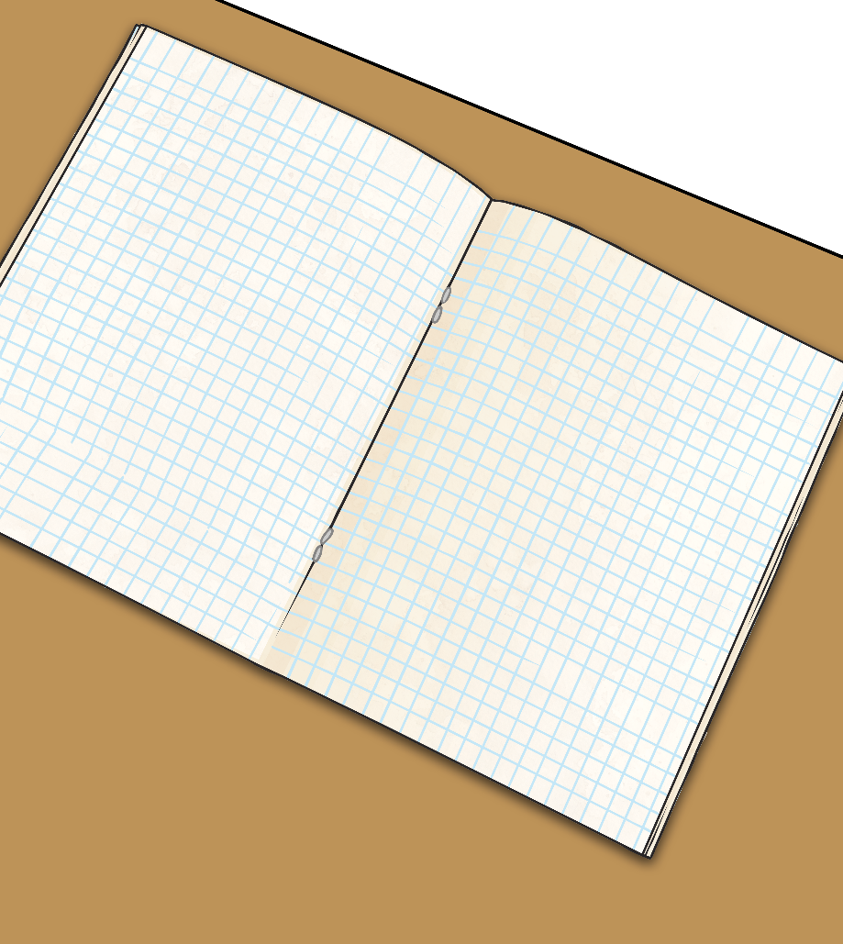
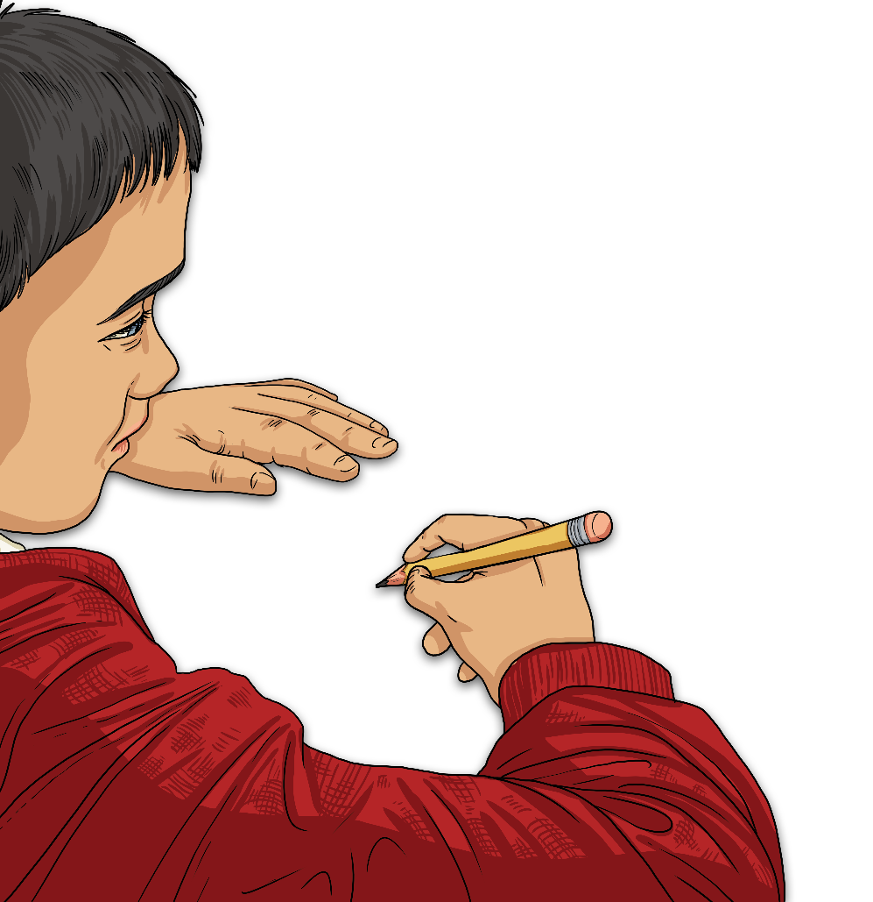
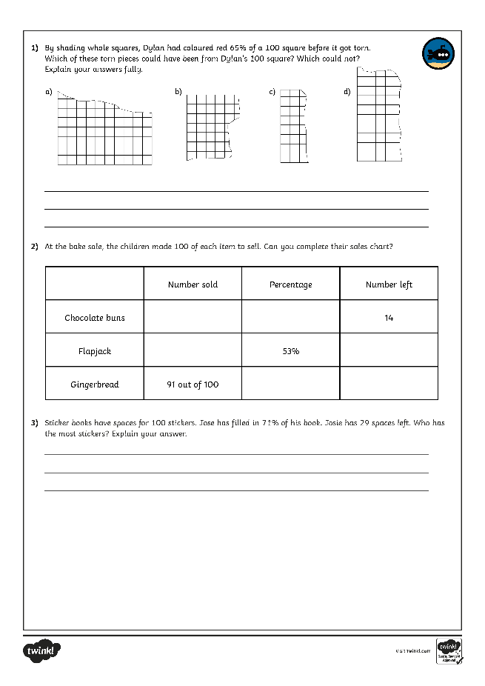
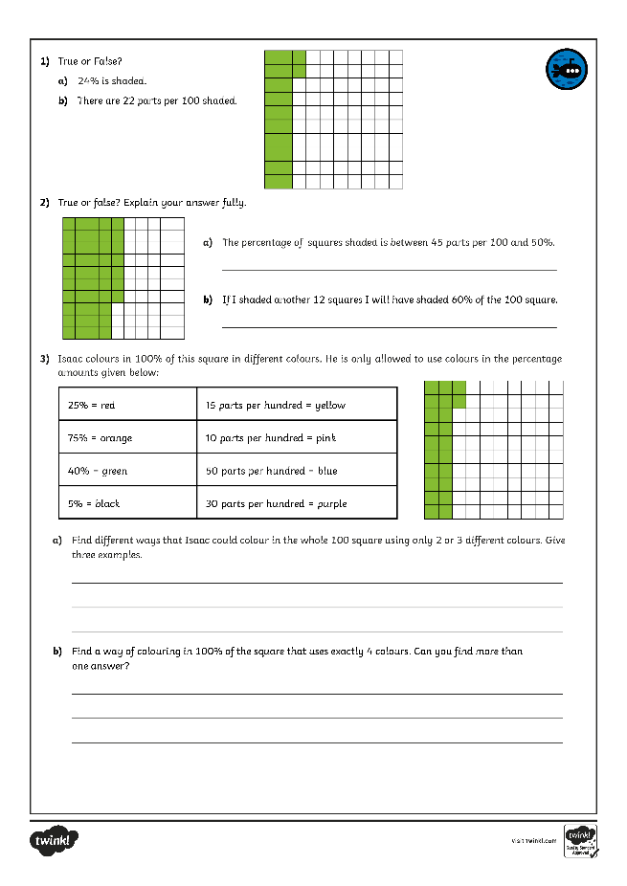
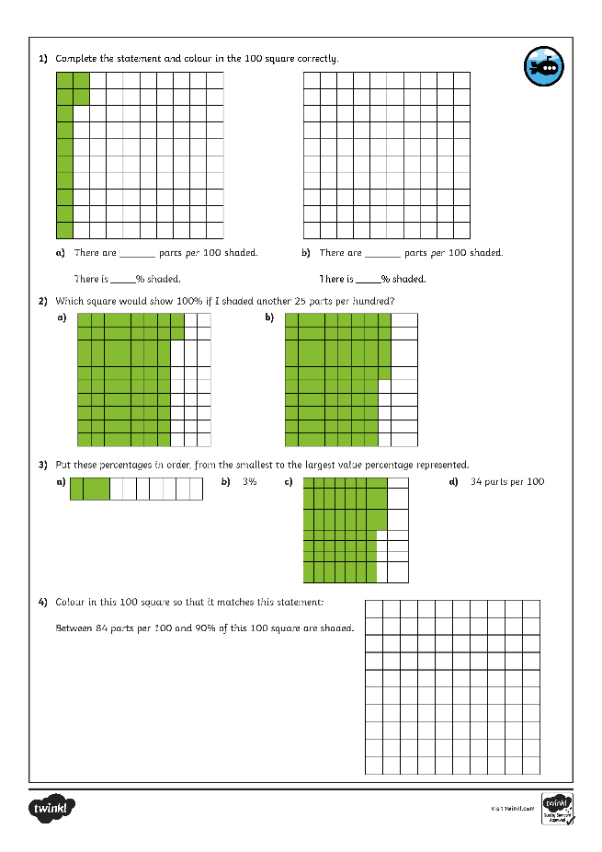
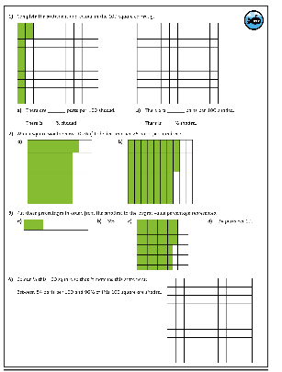
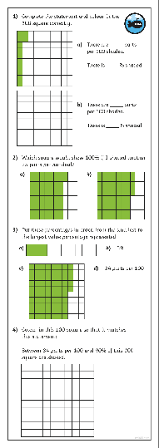
Understand Percentages
Dive in by completing your own activity!

Slide 9
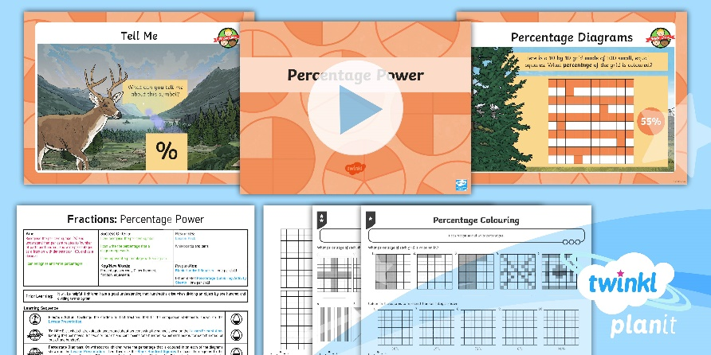
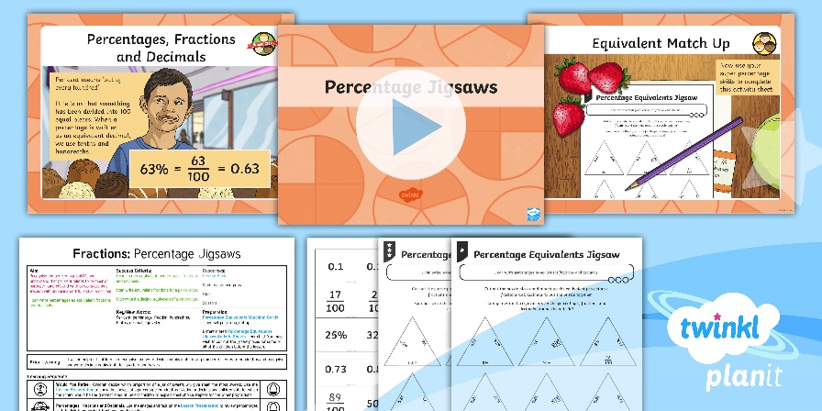
Need Planning to Complement this Resource?
National Curriculum Aim
Recognise the per cent symbol and understand that per cent relates to ‘number of parts per hundred’, and write percentages as a fraction with denominator 100, and as a decimal.
For more planning resources to support this aim, click here.
Twinkl PlanIt is our award-winning scheme of work with over 4000 resources.

