Slide 2
Diving into Mastery Guidance for Educators
Each activity sheet is split into three sections, diving, deeper and deepest, which are represented by the following icons:
These carefully designed activities take your children through a learning journey, initially ensuring they are fluent with the key concept being taught; then applying this to a range of reasoning and problem-solving activities.
These sheets might not necessarily be used in a linear way. Some children might begin at the ‘Deeper’ section and in fact, others may ‘dive straight in’ to the ‘Deepest’ section if they have already mastered the skill and are applying this to show their depth of understanding.
Diving
Deeper
Deepest

Slide 3
Aim
Solve problems involving the calculation of percentages and the use of percentages for comparison.

Slide 4
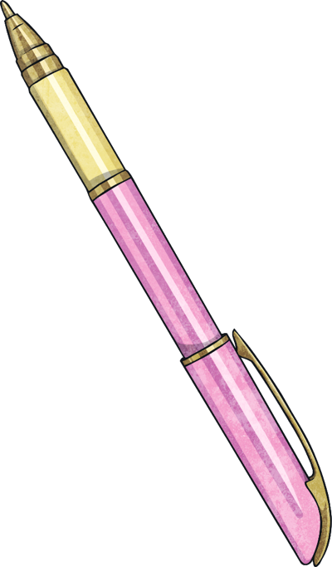
Percentages - Missing Values
Diving
Use the bar model to help answer the following question.
10% | 20% | 30% | 40% | 50% | 60% | 70% | 80% | 90% | 100%
240
10% = 24
Total =
a) 24 is 10% of what number?
24 is 10% of 240
b) When the bar model gives 10%, how does this help to show the value of the whole number?
When we know 10% is 24, we can see that 10 lots of 10% will make 100%.
24 × 10 = 240

Slide 5
Percentages - Missing Values
Diving
Use the bar model to help answer the following question.
10% | 20% | 30% | 40% | 50% | 60% | 70% | 80% | 90% | 100%
190
20% = 38
Total =
b) When the bar model shows 20%, how does this help to show the value of the whole number?
a) 38 is 20% of what number?
38 is 20% of 190
When we know 20% is 38, we can halve it to find 10%, which is 19. We can then find 10 lots of 19 to make 100% or the whole. 10 × 19 = 190 We could also find five lots of 20% to make 100%. 5 x 38 = 190

Slide 6
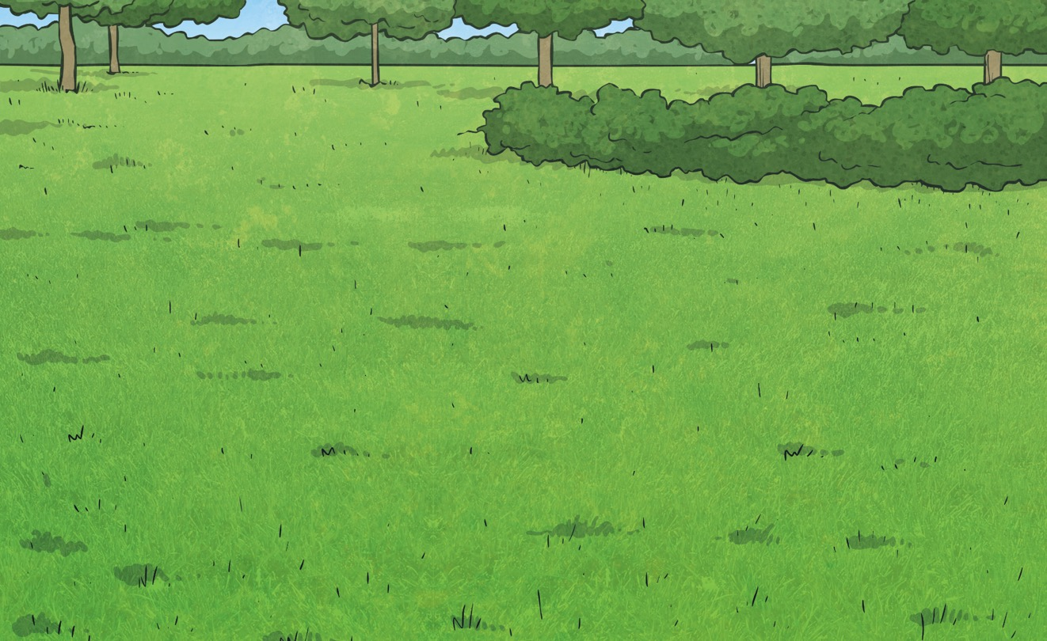
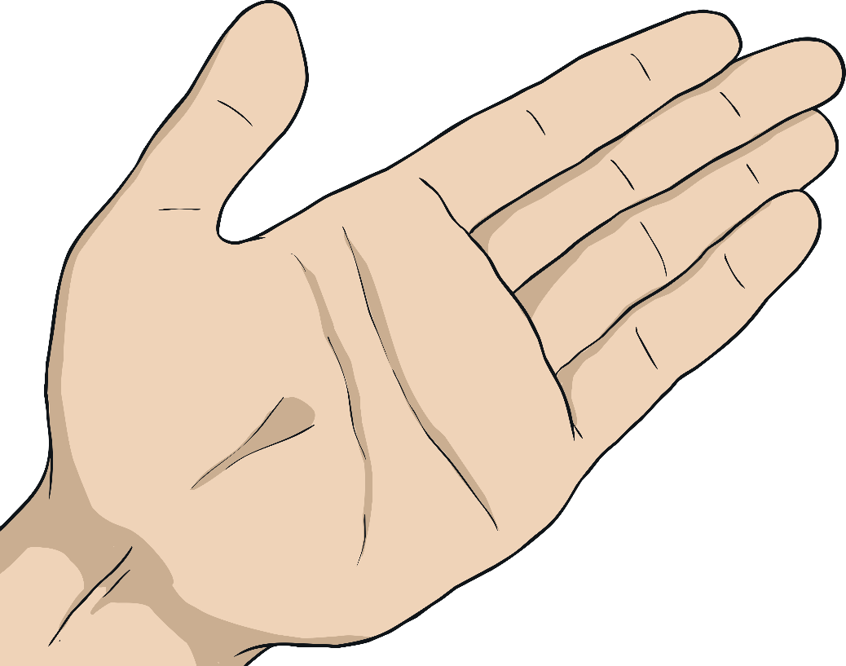
Percentages - Missing Values
Deeper
True or False?
The number 40 can complete all these statements correctly.
40
% of 70 = 25% of
40
40
40
20% of = % of 20
5% of = % of 5
False because 40% of 70 = 28 and 25% of 40 = 10.
True because 20% of 40 = 8 and 40% of 20 = 8.
True because 5% of 40 = 2 and 40% of 5 = 2.

Slide 7
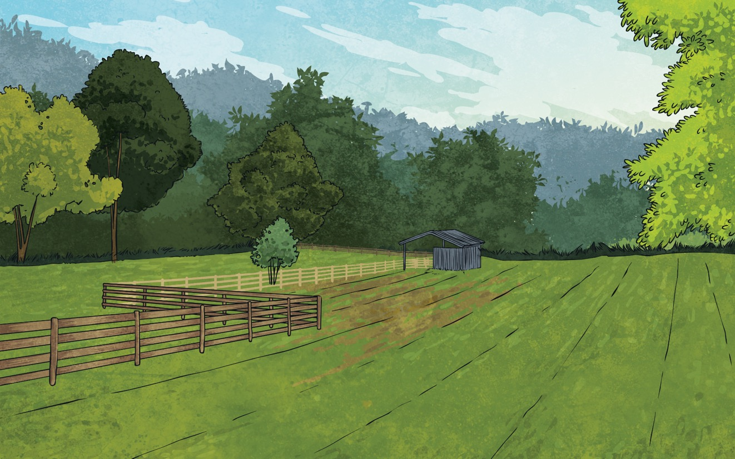
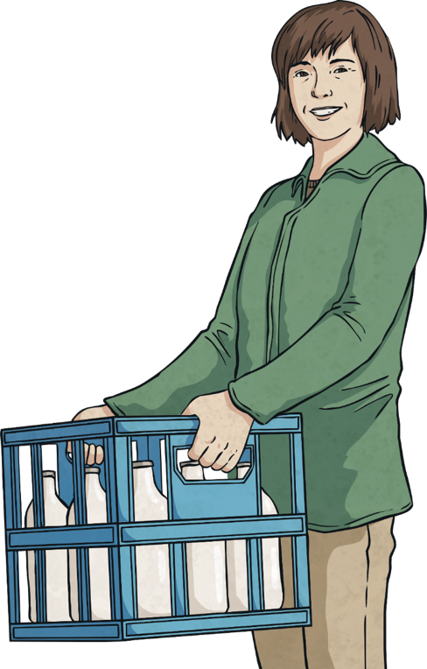
Percentages - Missing Values
Deepest
Use the information given to work out the size of the whole field and the missing measurements.
180m²
15% of the field measures 180m².
The whole size of the field is 24% + 41% of the field measures.
1200m²
.
65% = 780m²
.

Slide 8
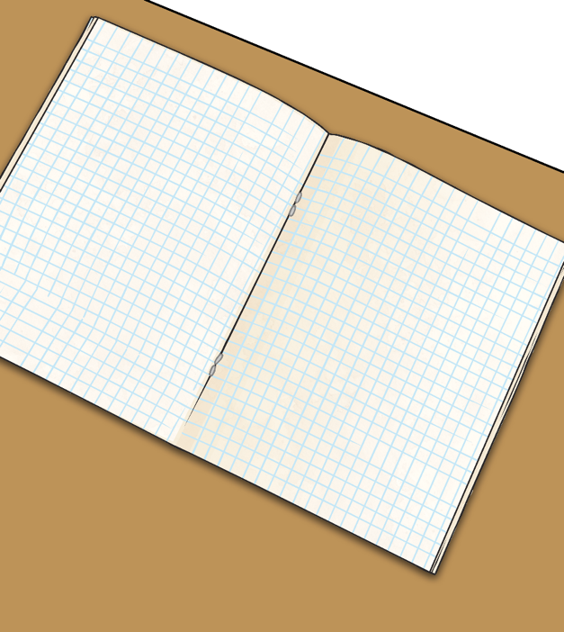
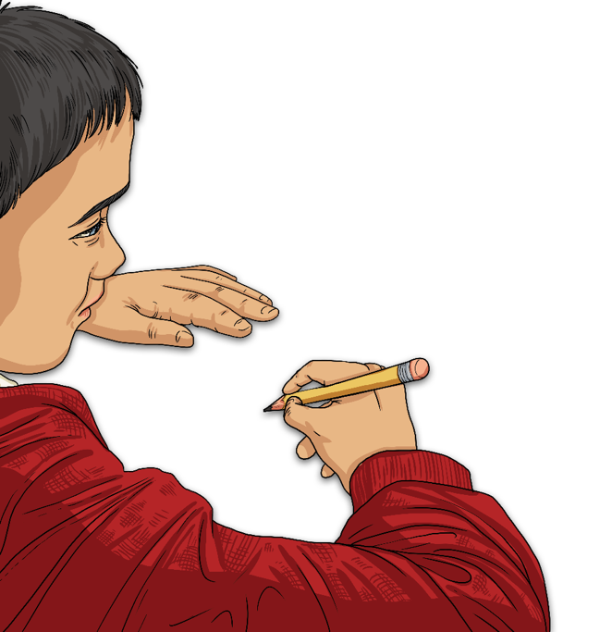
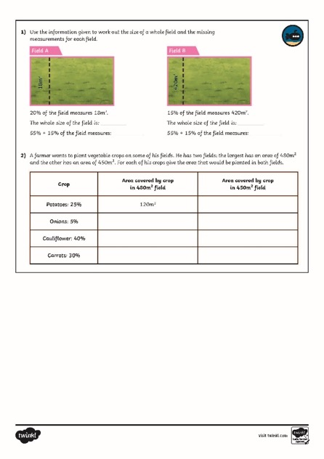
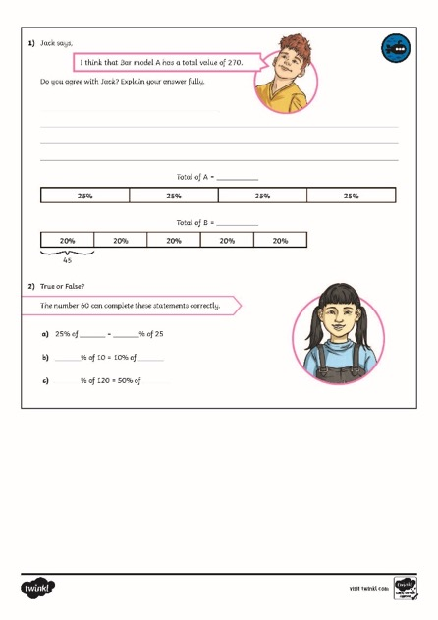
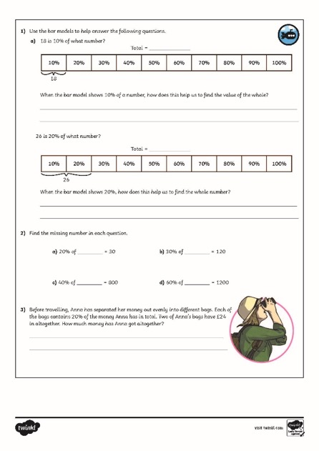
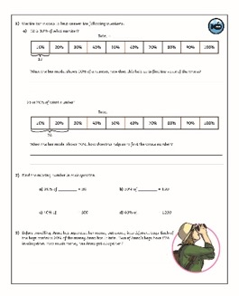
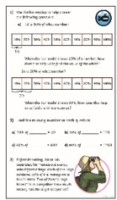
Percentages - Missing Values
Dive in by completing your own activity!

Slide 9
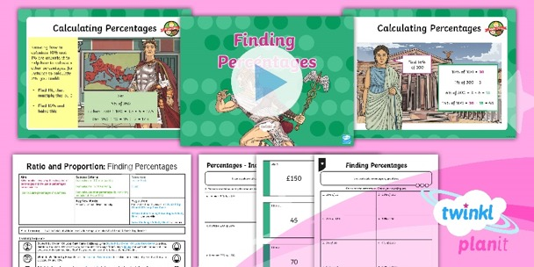
Need Planning to Complement this Resource?
National Curriculum Aim
Solve problems involving the calculation of percentages and the use of percentages for comparison.
For more planning resources to support this aim, click here.
Twinkl PlanIt is our award-winning scheme of work with over 4000 resources.

